Slide 1

Network Layer
Routing and Routing Algorithms
Distance Vector Routing
Lecture 12 | CSE421 – Computer Networks
Department of Computer Science and Engineering
School of Data & Science

Slide 2

Objectives
How routers learn routes
Static routing
Dynamic routing
  Distance Vector routing
  How routers exchange routing information
  Understand convergence and routing loops

Slide 3
Learning About Networks
A router can learn about remote networks in one of two ways:
Manually - Remote networks are manually entered into the route table using static routes.
Dynamically - Remote networks are automatically learned using a dynamic routing protocol.
Notes:
3
6.1.1.1

Slide 4

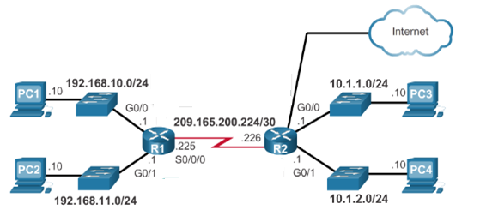
Learning About Networks
Table of R1
Network | Exit Int
192.168.10.0/24 | G0/0
192.168.11.0/24 | G0/1
209.165.200.224/30 | S0/0/0
Table of R2
Network | Exit Int
10.1.1.0/24 | G0/0
10.1.2.0/24 | G0/1
209.165.200.224/30 | S0/0/0
220.20.20.0/30 | G0/2
220.20.20.0/30
Directly connected
Directly connected
10.1.1.0/24
S0/0/0
10.1.2.0/24
S0/0/0
192.168.10.0/24
S0/0/0
192.168.11.0/24
S0/0/0
G0/2
S0/0/0

Slide 5
Static Route
Manually configured route
Used to reach networks not directly connected
Does not update automatically
Changes must be applied manually
Notes:
If there is no dynamic routing protocols

Slide 6
Static Route Advantages
Simple and predictable
More secure (not advertised)
Low CPU/memory usage
Notes:
6
Advantage of static routing
It is most secure way of routing, since no information is shared with other routers.
It puts no overhead on resources such as CPU or memory.
No routing algorithm or update mechanisms are required. Therefore, extra resources (CPU and memory) are not required.
It is easy to implement.

Slide 7
Static Route Disadvantages
Time-consuming to configure
Not scalable for large networks
No automatic failover
Requires full network knowledge
Solution : Dynamic Routing
Notes:
7
6.1.1.2

Slide 8
Why Do We Need Dynamic Routing?
Imagine a large network.
Many routers
Many networks
Links can fail
Networks can change
With static routing:
The administrator must change routes manually.
With dynamic routing:
Routers can learn routes automatically.
Notes:
8
6.1.1.2

Slide 9
Learning About Networks
Table of R1
Network | Exit Int
192.168.10.0/24 | G0/0
192.168.11.0/24 | G0/1
209.165.200.224/30 | S0/0/0
Table of R2
Network | Exit Int
10.1.1.0/24 | G0/0
10.1.2.0/24 | G0/1
209.165.200.224/30 | S0/0/0
220.20.20.0/30 | G0/2
220.20.20.0/30
Directly connected
Directly connected
10.1.1.0/24
S0/0/0
10.1.2.0/24
S0/0/0
192.168.10.0/24
S0/0/0
192.168.11.0/24
S0/0/0
G0/2
S0/0/0

Slide 10
Autonomous Systems (AS)
An Autonomous System (AS) is a group of networks and routers under the administrative control of a single organization (e.g. a university, ISP, or company).
Each AS is assigned a unique Autonomous System Number (ASN) by a regional internet registry.
Routing inside an AS → intra-domain routing
  Uses an Interior Gateway Protocol (IGP) — e.g. RIP, OSPF, EIGRP
Routing between different AS es → inter-domain routing
  Uses an Exterior Gateway Protocol (EGP) — in practice, BGP

Slide 11
Autonomous Systems — Example
AS 100
Uses IGP
AS 200
Uses IGP
AS 300
Uses IGP
R3
R4
EGP
EGP
R1
R2
R5
R6
R7
R8
Intra-domain (within an AS) — IGP: OSPF, RIP, EIGRP
Inter-domain — EGP: BGP

Slide 12
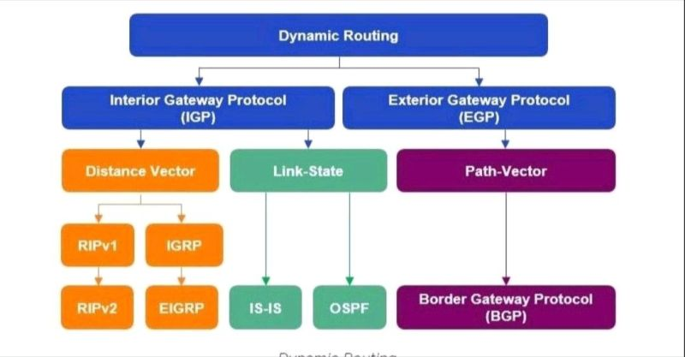
Popular Routing Protocols
Routing
Static Routing
Source:https://www.linkedin.com/posts/tejasvi-t_routing-protocols-can-be-categorized-into-activity-7126294906330910721-Psre/

Slide 13
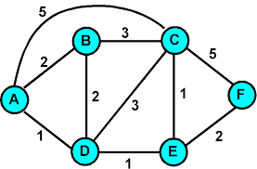
Routing Algorithms
Given a set of routers and links connecting the routers.
Routing algorithm finds a “good” path from the source to destination router.
Good path = a path with the lowest total cost

Slide 14
Routing Algorithm classification
Global:
Every router knows the whole network (all nodes, all links, and their costs).
Each router builds a complete map (topology).
Uses link state algorithms (like Dijkstra’s shortest path).
Decentralized:
Each router only knows about its neighbors and the cost to reach them.
Routers share information with neighbors and update step by step.
Uses distance vector algorithms (like Bellman-Ford).

Slide 15
Distance Vector Algorithm

Slide 16
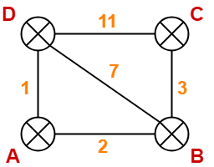
Distance vector algorithm
Based on Bellman-Ford Algorithm.
Each router finds shortest paths to all destinations.
Shortest path cost can be:
  Hop count
  Link Cost
  Delay
  Other metrics
Uses a weighted network (topology).
Notes:
16

Slide 17
How Does It Work?
Each router keeps a Distance Vector (table).
Router shares its table with neighbors regularly.
When a router gets a table from a neighbor, it updates its own table using the Bellman-Ford rule.
Repeat until routing information stabilizes.
Notes:
17

Slide 18
NODE D Table
NODE C Table
Node | Distance
A | 1
B | 7
C | 11
D | 0
Node | Distance
A | No Info
B | 3
C | 0
D | 11
12
Cost to A = cost(to neighbor) + neighbor’s cost(to destination)
D Router
Cost to A from D Router
11
+
1
Distance Vector Algorithm:
Cost to a destination ==cost(to neighbor) + neighbor’s cost(to destination)

Slide 19
Periodic Updates of Distance Vector
Routers regularly send their entire routing table to neighbors.
These updates are sent even when there is no change in the network.
This is simple but inefficient.
Notes:
Inefficient: Updates consume bandwidth and router CPU resources.
Periodic updates are always sent even there have been no changes for weeks or months.

Slide 20
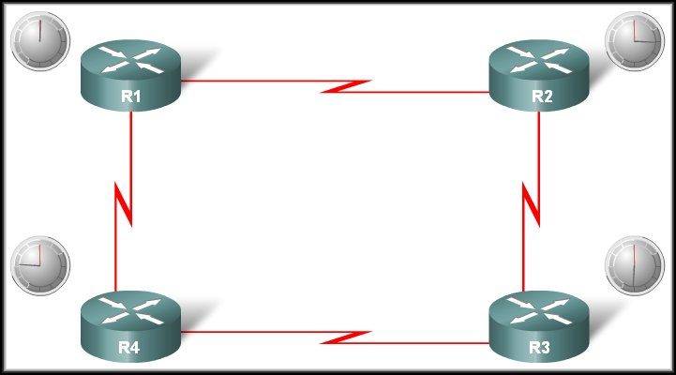

Operation of Distance Vector
Periodic Updates:
R1 Update Timer expires
Neighbour of R1
Updates sent.
Broadcast!
R1 is unaware of R3 and its networks
Neighbour of R1

Slide 21
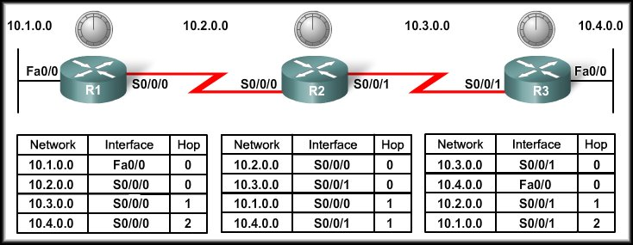
Distance Vector Routing Protocols - RIP
Network Discovery

Slide 22
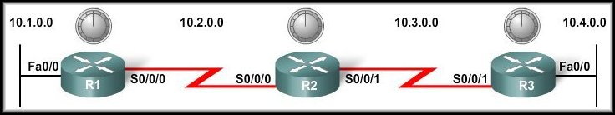
Cold Start
Network Discovery:
  Is part of the process of the routing protocol algorithm that enables routers to learn about remote networks for the first time.

Slide 23
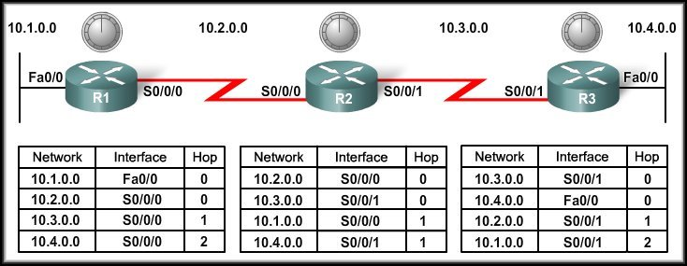
Cold Start
When a router powers up:
  Knows nothing about the network topology.
  Knows only the information saved in NVRAM.
  Sends updates about its known networks out all ports.

Slide 24
Knowing it’s own connected networks
Notes:
Sends an update about network 10.1.0.0 out the Serial 0/0/0 interface with a metric of 1.
Sends an update about network 10.2.0.0 out the Fa0/0 interface with a metric of 1.

Slide 25
Initial Exchange of Routing Information
10.2.0.0
10.3.0.0
10.1.0.0
10.4.0.0
10.3.0.0
10.2.0.0
10.2.0.0
10.3.0.0
Notes:
Sends an update about network 10.4.0.0 out the S0/0/0 interface with a metric of 1.
Sends an update about network 10.3.0.0 out the Fa0/0 interface with a metric of 1.

Slide 26
Exchange of Routing Information
Notes:
Sends an update about network 10.1.0.0 out the S0/0/0 interface with a metric of 1 - AGAIN!
When R2 receives the update, there is no change in information so the update is ignored.

Slide 27
Next Exchange of Routing Information
NEW
NEW
10.3.0.0
10.4.0.0
10.1.0.0
10.2.0.0
Notes:
Sends an update about networks 10.3.0.0 with a metric of 1 and 10.4.0.0 with a metric of 2 out the Serial 0/0/0 interface.
Similarly sends updates about networks 10.1.0.0 with a metric of 2 and 10.2.0.0 with a metric of 1 out the Serial 0/0/1 interface.

Slide 28
Next Exchange of Routing Information
  The network has CONVERGED!
    All routers now know about all of the networks attached to all of their neighbouring routers.

Slide 29
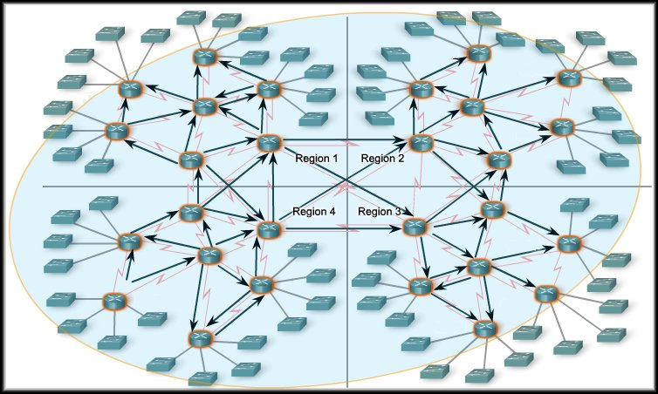
Convergence
Convergence is the time a network takes to reach a stable routing state after a change (e.g., link failure).
In general, larger networks take longer to converge.
Routing protocols are compared based on how fast they spread routing updates
→ this is called speed of convergence.
A network cannot forward traffic correctly until convergence is complete.
Notes:
Therefore, network administrators prefer routing protocols with faster convergence.

Slide 30
Disadvantages
Routers have only local knowledge (they know information only from neighbors).
Routers trust information received from neighbors, even if it is outdated or incorrect.
Routing updates are slow to converge after a link failure.
Incorrect routing information can spread from one router to another.
This can create routing loops.
Notes:
Therefore, network administrators prefer routing protocols with faster convergence.

Slide 31
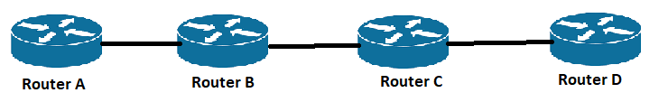

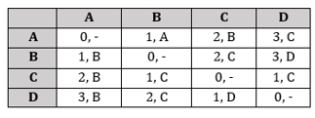
Count to infinity Problem :: Routing Loops
∞, A
B
C
Notes:
As you see in this graph, there is only one link between A and the other parts of the network.
➢ Now imagine that the link between A and B is cut.
➢ At this time, B corrects its table.

Slide 32
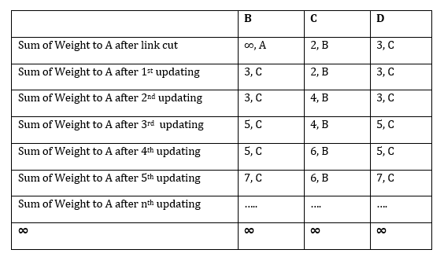
Count to infinity Problem :: Routing Loops
Routing Table of C
After a specific amount of time, B receives C's routing table.
Since C does not know that the link between A and B is down, it assumes a path to A with cost 2 (1 from C to B and 1 from B to A).
B receives C’s table and assumes there is an alternate path to A via C
So it updates its distance to A from infinity to 3 (1 from B to C + 2 from C to A)
Once again, routers exchange their tables.

Slide 33
Count to infinity Problem :: Routing Loops
Routing Table of B
When C receives B's routing table, it sees that B has changed the weight of its link to A from 1 to 3.
So C updates its table and changes the weight of the link to A to 4 (1 for C to B, and 3 for B to A, as B said).
This process loops until all nodes find out that the weight of link to A is infinity.
2nd updating

Slide 34
Solution One: Split Horizon Rule
Routing Table of C, No info of A Network
One way to solve this problem is that a router does not advertise a route back out the interface on which it was learned.
Or “Poison reverse”: advertise that route back to the neighbor with an infinite metric.
In this case, C shouldn't send any information to B about A, because B is the only way to A.

Slide 35
Static vs. Dynamic Routing
Aspect | Static Routing | Dynamic Routing
Definition | Routes manually configured by the admin | Routes learned and updated automatically via a routing protocol
Configuration | Manual, on each router | Automatic, routers exchange info
Resource Usage | Low CPU, low bandwidth | Higher CPU, more bandwidth
Scalability | Not scalable for large networks | Highly scalable for large networks
Fault Tolerance | No automatic backup; manual changes needed | Automatically finds alternate paths on link failure
Security | More secure (no updates advertised) | Less secure (routing updates are sent between routers)
Best For | Small networks with stable topology | Large networks with frequent changes

Slide 36
Network Layer
Routing Algorithm
Distance Vector Routing
Lecture 12 | CSE421 – Computer Networks
Department of Computer Science and Engineering
School of Data & Science

Slide 37
Does not maintain a list o neighbours with their states (Up/down) and last heard time
Just maintains a timer. If the timer exceeds 180 sec, the router is considered as dead and all routes learned from it are removed.
The revised routing table is instantly sent to all other neghbors

Slide 38
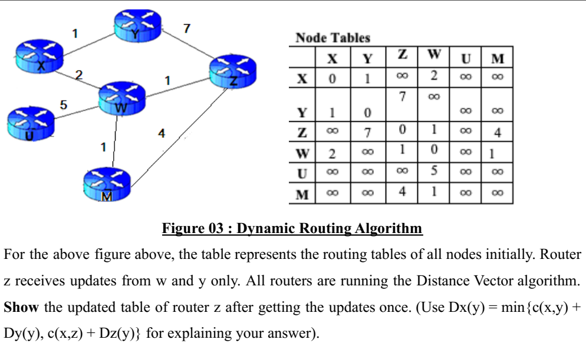
A’s distance vector
3
7
0
1
∞
2

Slide 39
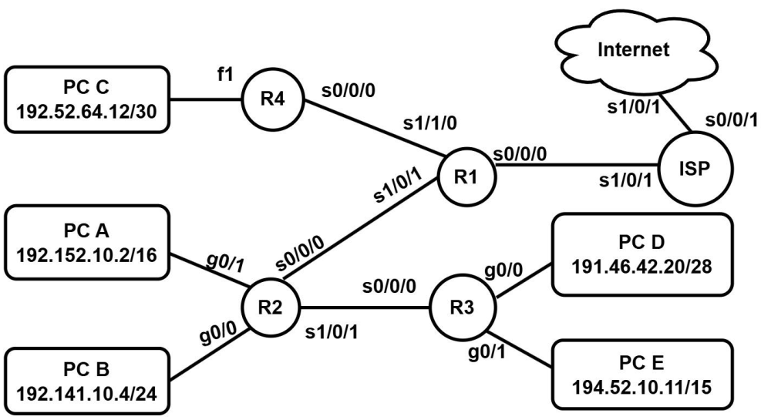
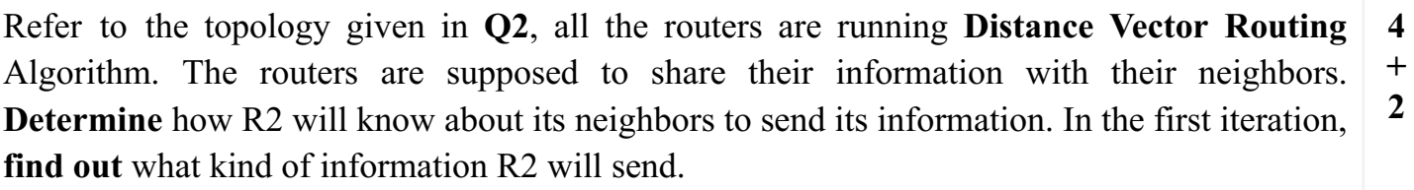
From the directly connected network list
List of network addresses of PC A, PC B, the WAN connected to s0/0/0 and s1/0/1 interfaces with hop count 0 for all.

Slide 40
Each router determines route based on local information (information from its neighbor only).
There is no directly global information exchange.
A router does not have the complete Map of the network
No neighbor discovery process.
Slower than LS routing

Slide 42
THE END

